Slide 1
KMMI
SNR
Tugas Akhir Kelompok
Talitha Irma Ariani B11.2019.05901 Manajemen
Agustina Nur Indriati D11 2019.02891 Kesehatan Masyarakat
Widho Faisal Hakim A11.2020.12409 Teknik Informatika
UDINUS 2020
Using Rstudio and Gephi

Slide 2
RStudio
01
Mengimpor dataset covid19_tweet.csv
02
Memfilter kolom text dengan kata kunci “vaksin”
03
Lakukan preprocessing dataset covid19_tweet
04
Lakukan export dataframe ke file .gexf

Slide 3
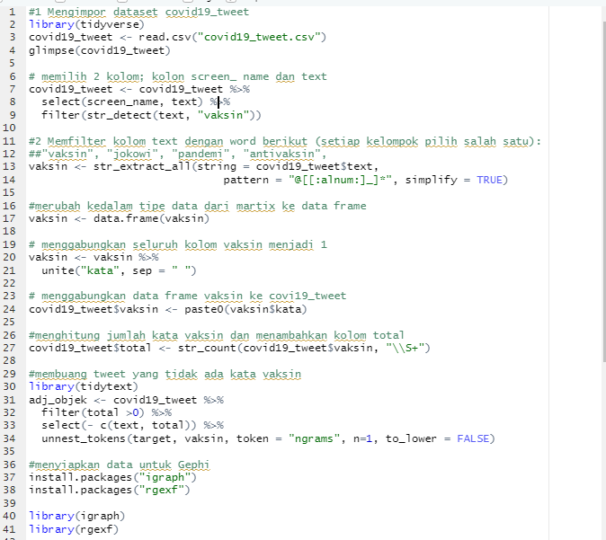
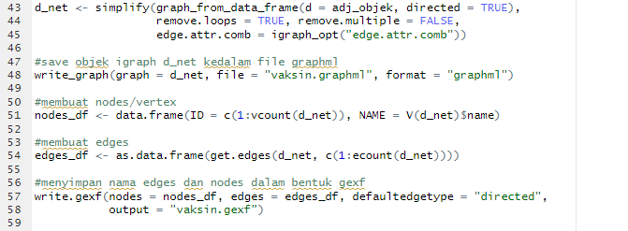
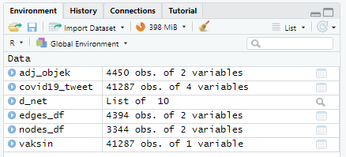
Script kode RStudio
Add Text
Add Text
Get a modern PowerPoint Presentation that is beautifully designed.
Get a modern PowerPoint Presentation that is beautifully designed.
Get a modern PowerPoint Presentation that is beautifully designed. I hope and I believe that this Template will your Time, Money and Reputation. Easy to change colors, photos and Text. You can simply impress your audience and add a unique zing and appeal to your Presentations.
Easy to change colors, photos and Text. You can simply impress your audience and add a unique zing and appeal to your Presentations.

Slide 4
Gephi
05
Buka file .gexf yang dibuat dari langkah 4 di Gephi
06
Setting visualisasi network
(centrality, layout, size, color)

Slide 5
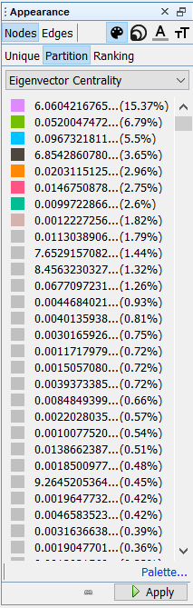
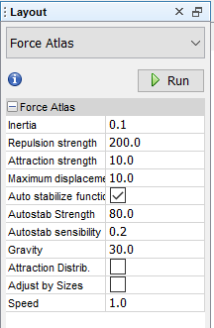
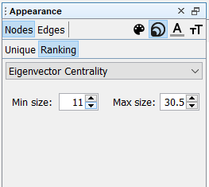
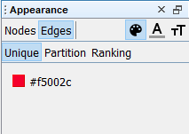
Preset Gephi

Slide 6
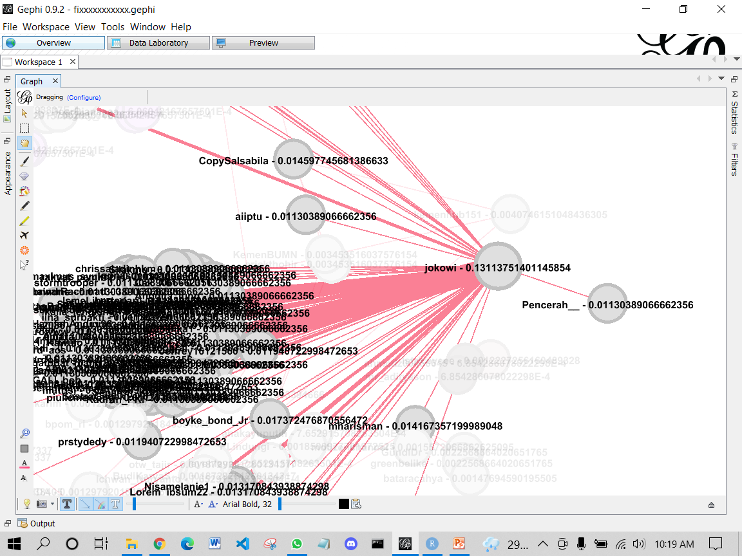
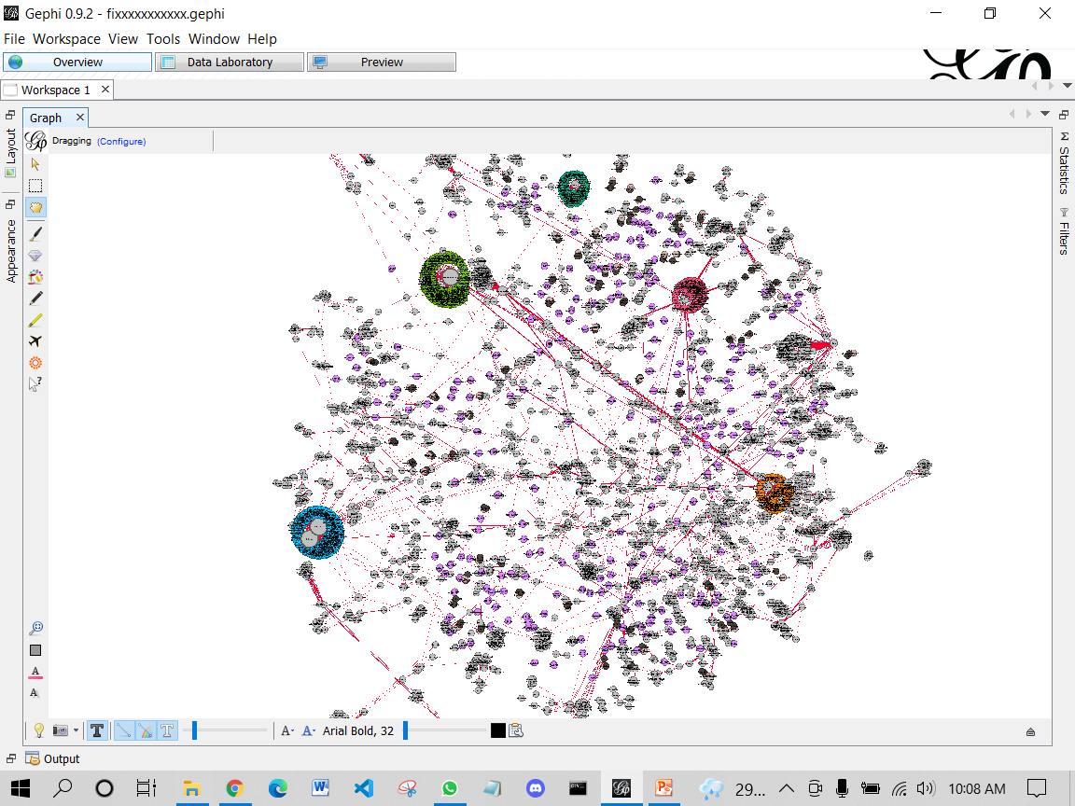
Hasil ketika di zoom in

Slide 7
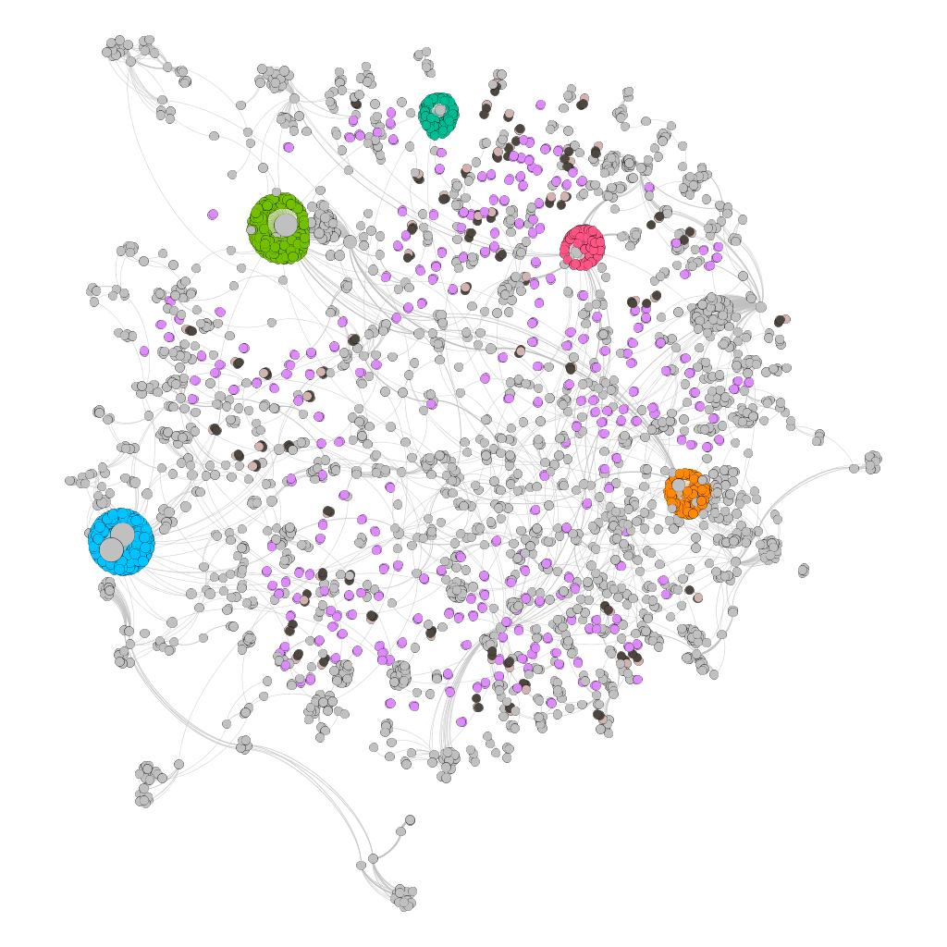
Hasil export

Slide 8
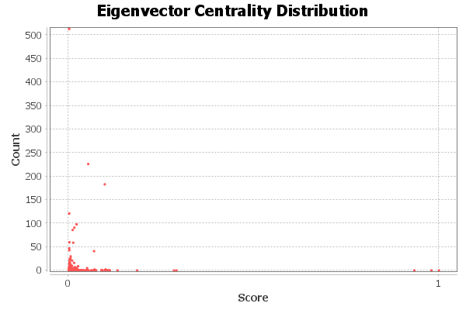
Visualisasi eigenvector centrality
Eigenvector Centrality Report
Parameters:
Network Interpretation: undirected Number of iterations: 100 Sum change: 0.10266852358072695 Results:

Slide 9
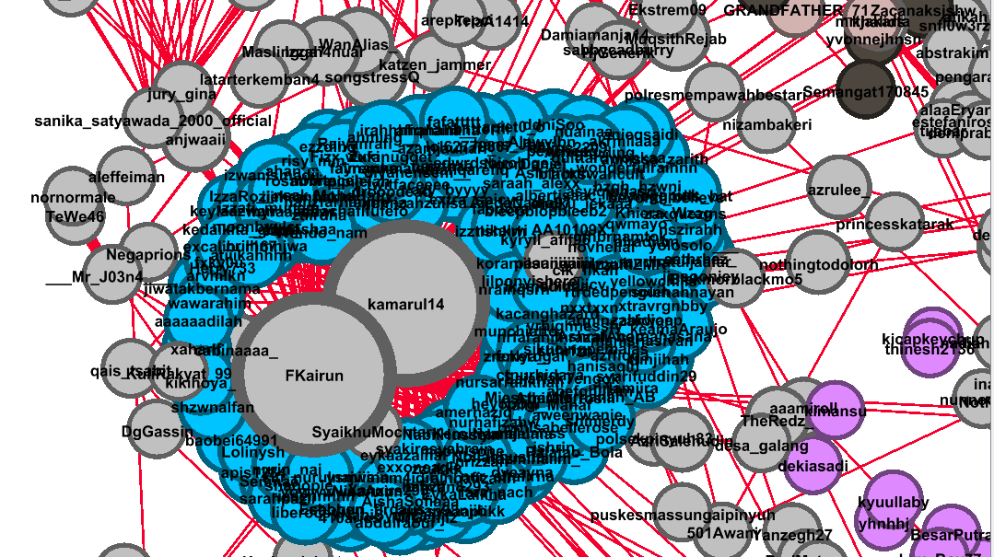
Kesimpulan ada 5 kelompok nodes besar
Source Data Laboratory Gephi

Slide 10
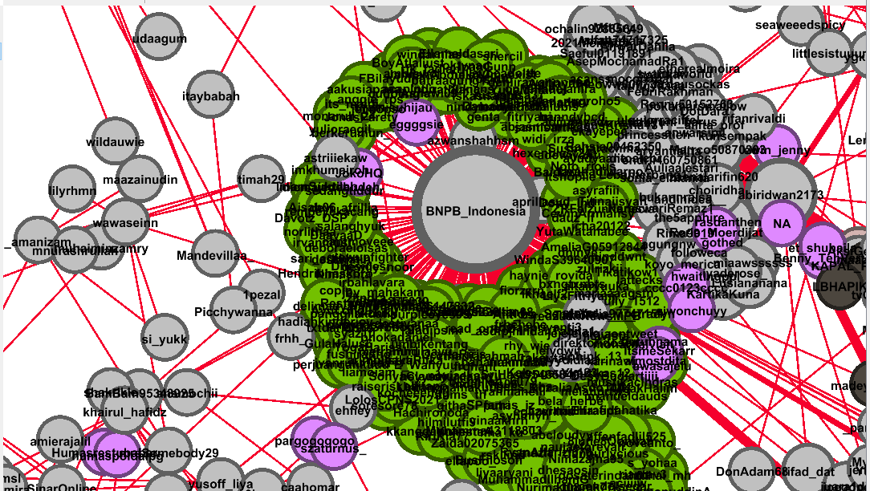

Slide 11
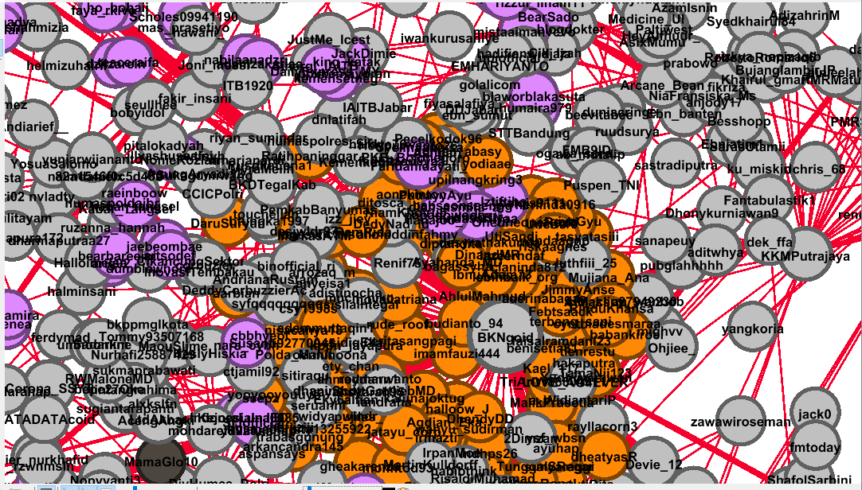

Slide 12
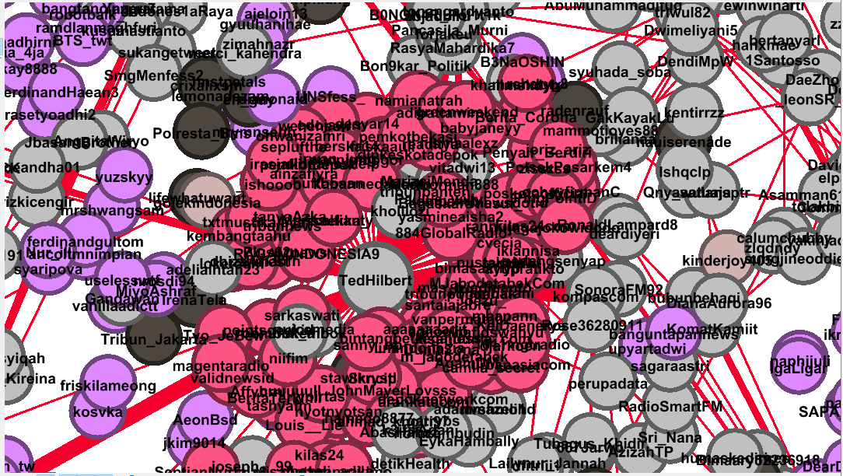

Slide 13
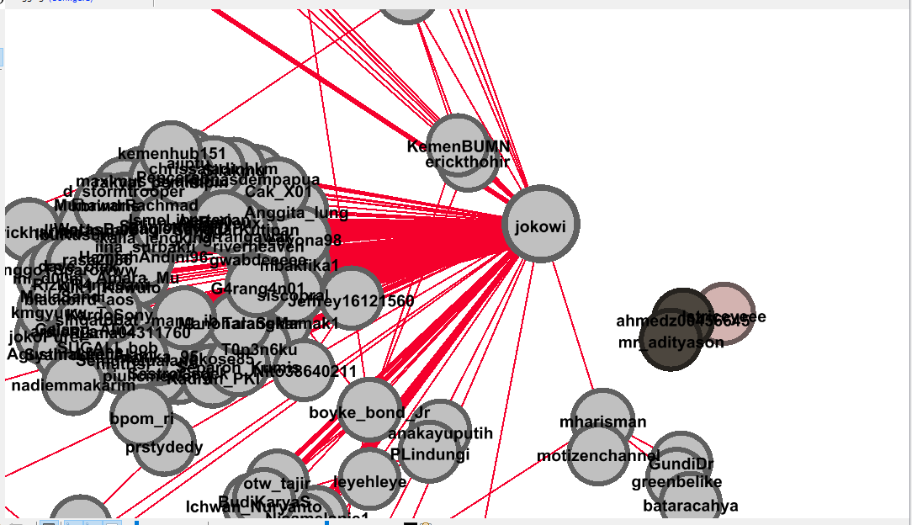

Slide 14
TERIMAKASIH

